Slide 1

AUTOMATIC MAIL SENDER WITH VOICE DETECTION
CS409PC: Real-time Research Project\Societal Related Project

Slide 2
Contents
Abstract
Introduction
Purpose of the project
Existing system and disadvantages
Proposed System with Features
System requirements
Design and Implementation models
Use case diagram
Output/Results
Conclusion
Future Enhancements
Reference

Slide 3
Abstract
The main idea of Our project is to create an innovative email system that allows users to send emails through voice commands. Users can dictate the recipient’s email address, subject, and message content effortlessly by eliminating manual typing.
This system caters to both convenience and accessibility. Users, including those with visual impairments, can access their emails without relying on traditional Braille keyboards. The voice-based interface streamlines the process, making it efficient and user-friendly.

Slide 4
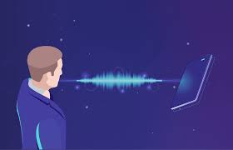
Introduction
A voice mail system is a computer-based system that allows users and subscribers to exchange messages without typing. emails are very important for communication as each professional communication can be done by email and the best service for sending and receiving mail is as we all know GMAIL. Gmail is a free email service developed by Google.
Normal Gmail does not contain the voice recording option. In this project, we are designing a record option and the recorded voice is converted to text and sent to the particular mail. Nowadays many people are very busy, so they are interested in recording a message and sending it instead of typing it.

Slide 5


Purpose of the project
Our project focuses on automating email sending using voice recognition, eliminating the need for manual typing. This innovation benefits both visually challenged individuals and those with physical disabilities.
Email remains a crucial communication channel, and our system aims to provide a seamless user experience. By allowing users to send emails through voice commands, we empower them to communicate efficiently without relying on traditional keyboards.
Our application caters to a wide audience, including both visually impaired users and the general population. By automating email composition, we reduce human effort and save time.

Slide 6
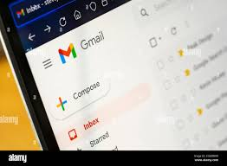
Existing system and disadvantages
Many email users rely on screen readers to access content. However, screen readers struggle with mouse-based interactions, making it difficult for visually impaired individuals to navigate email interfaces.
Existing systems often require users to learn keyboard shortcuts, which can be cumbersome. Additionally, mobile applications lack features that interpret information from the camera, hindering accessibility.
Our project aims to address these limitations by creating a voice-controlled email system. Users can send emails without typing, benefiting both visually challenged individuals and the general population.
Unlike existing systems, our solution bridges the gap between voice recognition technology and email communication, providing a more inclusive and efficient experience.

Slide 7
Proposed System with Features
The proposed system aims to improve email accessibility, particularly for visually challenged individuals. By prioritizing user-friendliness across diverse user profiles, including traditional users, visually impaired individuals, and even illiterate users, the system ensures equitable access.
Through voice prompts and automated field scanning during registration, users can easily sign up. Upon successful registration, voice-based authentication allows users to log in securely, converting spoken credentials to text. Subsequently, users can access essential email sections like Compose, Inbox, and Sent Mail.
Our system bridges the gap between voice recognition technology and email communication. By prompting users through voice commands, we simplify the process of availing various services.

Slide 8
System requirements
Software Requirements
Tools Used:
• Pycharm.
• Interpreters for scripts.
• Google Speech-to-text and text-to-speech Converters.
• Pyttsx text-to-speech API in Python
Hardware Requirements
Windows Desktop
Minimum: Dual-core processor Recommended: Quad-core processor
Minimum: 2 GB Recommended: 4 GB or more
Minimum: 500 MB of free disk space
Recommended: 1 GB or more for additional space for data growth
Minimum: 1024x768 resolution Recommended: 1366x768 or higher

Slide 9
Design and Implementation models
Phase 1: Voice-Prompted Tasks:
In the initial phase, the system prompts users to perform specific tasks using voice commands. The background Python module pyttsx3 handles text-to-speech conversion.
Users provide input through speech, which is converted to text using the Google Speech API. Based on this input, the system performs tasks such as logging into Gmail, sending emails, and reading received emails.
Phase 2: Speech Input Handling:
In the second phase, users continue to interact with the system through speech input. The speech_recognition module (a Python library) manages voice requests and converts them into text.
Upon receiving input, the system stores relevant responses in variables. Depending on these values, it proceeds to the appropriate modules for further processing.

Slide 10
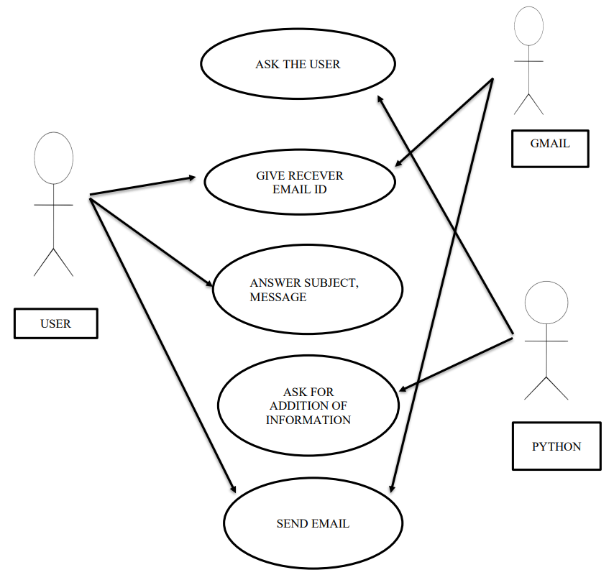
Use case diagram

Slide 11
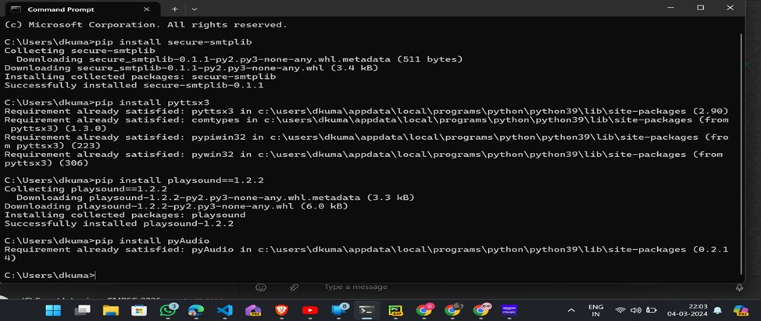

Slide 12
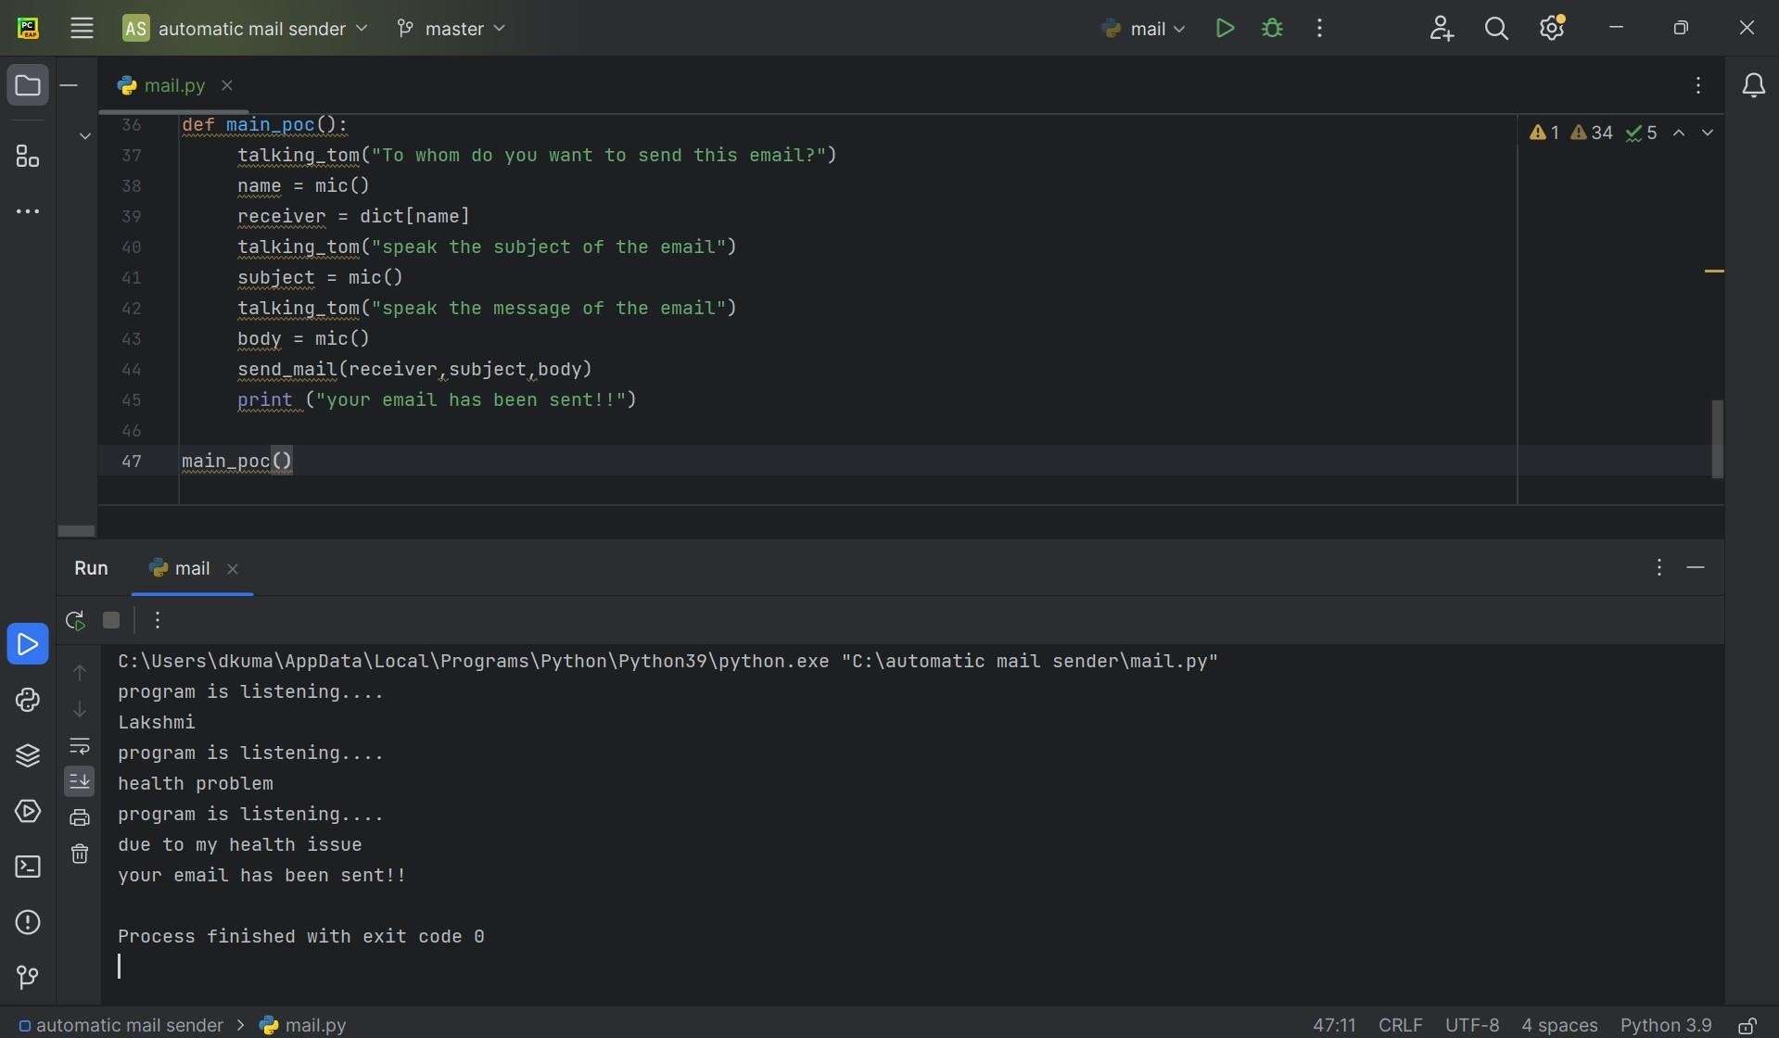

Slide 13
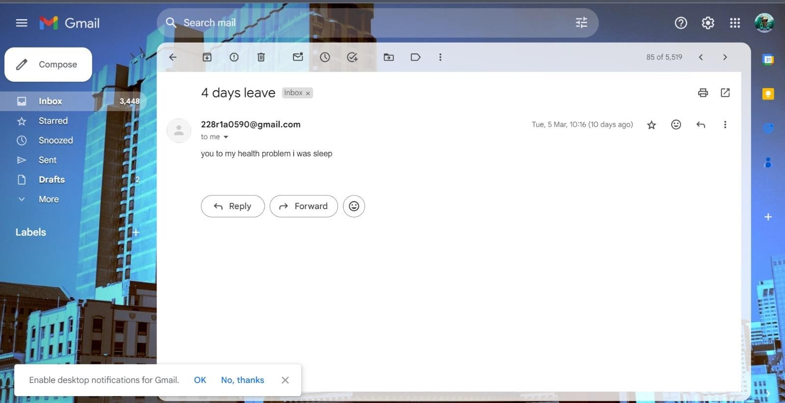
Output/Results
After use the VOICE DETECTION this the out put ..

Slide 14
Conclusion
Our proposed solution aims to improve email accessibility for visually challenged individuals. By eliminating the need for keyboard shortcuts and leveraging screen readers, we reduce the cognitive load associated with remembering complex key combinations.
Users simply follow voice prompts provided by an Interactive Voice Response (IVR) system and perform mouse clicks to access email services. Additionally, voice inputs are used when necessary. Given that India hosts over of the world’s blind population, this architecture addresses a critical need.
Our email system caters to users of all ages, making it universally accessible. It features both speech-to-text and text-to-speech capabilities, allowing visually impaired individuals to send and receive emails effortlessly using voice commands.

Slide 15
Future Enhancements
This voice-based email system addresses the challenges faced by visually impaired individuals when accessing emails.
The system eliminates the need for keyboard shortcuts and relies on screen readers and mouse cursor feedback. Remarkably, the world’s blind population resides in India, making this solution crucial. It not only facilitates email communication, but allows blind users to navigate seamlessly.

Slide 16
References
[1] Jagtap Nilesh, Pawan Alai, Chavhan Swapnil and Bendre M.R.. “Voice-Based System in Desktop and Mobile Devices for Blind People”. In International Journal of Emerging Technology and Advanced Engineering (IJETAE), 2014 on Pages 404-407 (Volume 4, issue 2).
[2] Ummuhanysifa U.,Nizar Banu P K , “Voice Based Search Engine and Web page
Reader”. In Internationa Journal of Computational Engineering Research (IJCER). Pages 1-
[3] K. Jayachandran and P. Anbumani “Voice Based Email for Blind People” in International Journal of Advance Research, Ideas and Innovations in Technology(IJARIIT),2017 on Pages 1065-1071

Slide 17
II CSE B Batch 2
Internal Guide- Dr.Rafeeq Mohammed
Associate Professor, Dept. of CSE, CMR Engineering College, Hyderabad
Deepak Kumar Sahoo, 228R1A0590
Mohammed Yaseen, 228R5A05A9
Illury Benjamen, 228R5A0598
Palle Deepak, 228R1A05B3

Slide 18
THANK YOU

